Slide 1

Neuromodulation in pelvic floor disorders: science or faith?
Prof. Luigi Brusciano MD PhD
Associate Professor of General Surgery
University of Campania "Luigi Vanvitelli" Italy
Proctological and Pelvic Floor Surgery
Coordinator of the
1st Level Master in Instrumental Diagnostics and Pelvic Floor Rehabilitation and
of the 2nd Level Master in Colonproctology and Pelvic Floor Pathologies

Slide 2
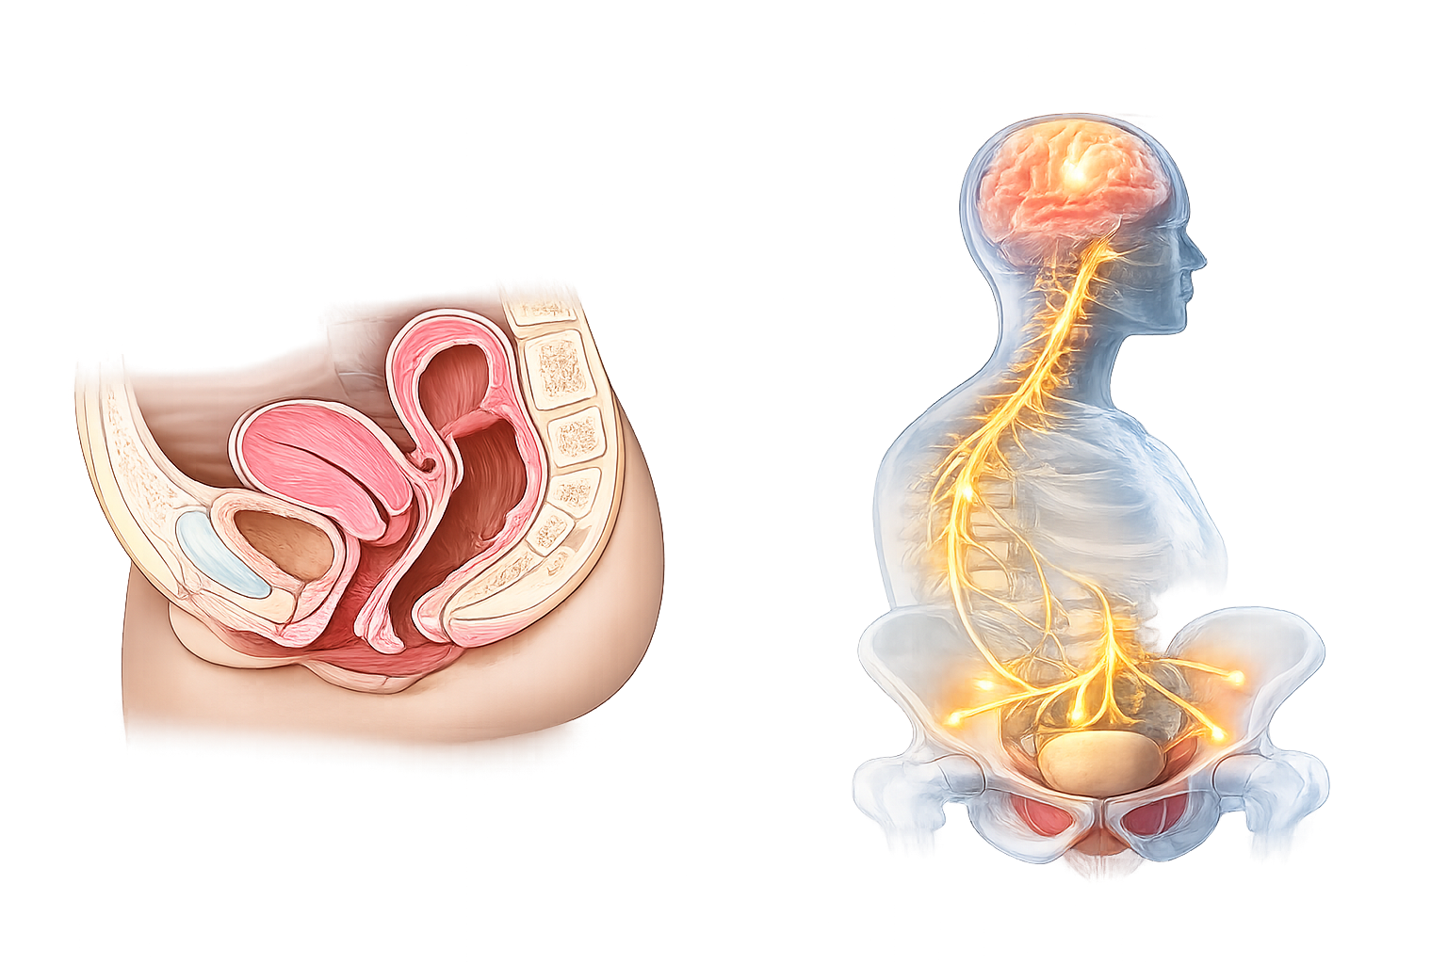
The Pelvic Floor: Organic vs. Functional Disorders
Organic Forms
Functional Forms
Linked to anatomical alterations — prolapse, sphincter defects, structural damage. Surgery is often curative and well-established.
Driven by dysregulation of neural control — the target of neuromodulation:
  Constipation (slow transit & obstructed defecation)
  Fecal incontinence (multifactorial)
  Pelvic pain — hyperafference, levator spasm
Notes:
2

Slide 3
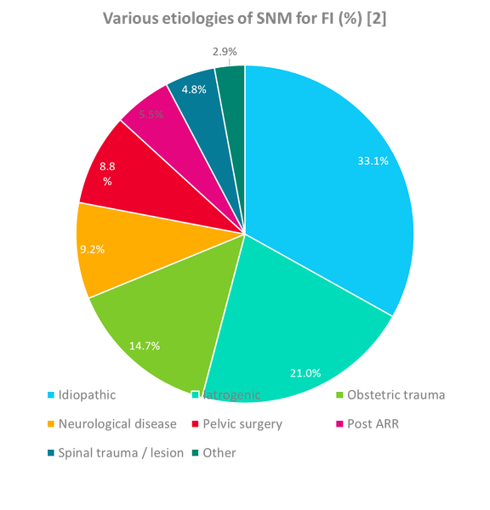
SNM: Approved Indications
AFTER CONSERVATIVE THERAPIES HAVE FAILED
Overactive Bladder LoE 1 / GoR A
Fecal Incontinence LoE 2 / GoR B
OAB wet (urge urinary incontinence) and OAB dry (urgency-frequency syndrome)
≥1 solid or liquid incontinence episode/week after failed conservative treatment
Non-Obstructive Urinary Retention LoE 1 / GoR A
Constipation LoE 4 / GoR D
Off-label use; evidence less uniform — the most contested indication
Detrusor underactivity of idiopathic, neurogenic, or post-surgical etiology
SNM is the preferred treatment option for patients with combined uro-proctological pelvic floor dysfunctions — acting simultaneously on multiple symptoms.
*after conservative therapies have failed
LoE: Level of Evidence; GoR: Grade of Recommendation
▪ off-label use as primary SNM indication
[1] Goldman HB et al. International Continence Society best practice statement for use of sacral neuromodulation. Neurourol Urodyn. 2018 Jun;37(5):1823-184]
[3] Matzel KE et al. Sacral spinal nerve stimulation for faecal incontinence: multicentre study. Lancet. 2004 Apr 17;363(9417):1270-6.
ARR: anterior rectal resection
[2] Altomare DF et al. Long-term outcomes of sacral nerve stimulation for faecal incontinence. Br J Surg. 2015 Mar;102(4):407-15.
Notes:
3

Slide 4
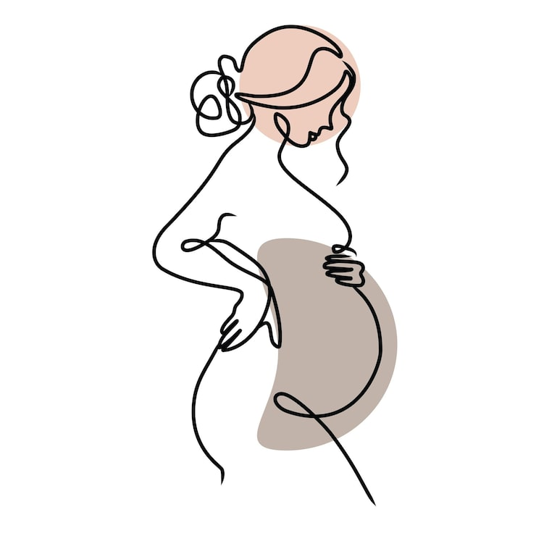
Contraindications for SNM
  Absolute contraindications for SNM includes:
    Inadequate clinical response to a therapeutic trial
    Inability to operate the device with lack of supportive caregivers who could otherwise offer assistance
    Pregnant patients
    (Level of Evidence: IV, Grade of Recommendation: C)
  Relative contraindications for SNM includes:
    Patients with severe or rapidly progressive neurologic disease
    Patients with established complete SCI
    Patients with abnormal sacral anatomy (Level of Evidence: III, Grade of Recommendation: C)
    Patients with chronic diarrhea (FI)
  The panel recommends not implanting a SNM device in a pregnant woman and deactivating the device when a patient already on SNM therapy becomes pregnant.
  Other contraindications: bleeding disorders, pilonidal sinus, present prolapse, general contraindications for surgeries
Goldman HB, Lloyd JC, Noblett KL, Carey MP, Castaño Botero JC, Gajewski JB et al (2018) International Continence Society best practice statement for use of sacral neuromodulation. Neurourol Urodyn Apr 11. doi: 10.1002/nau.23515. [Epub ahead of print]

Slide 5
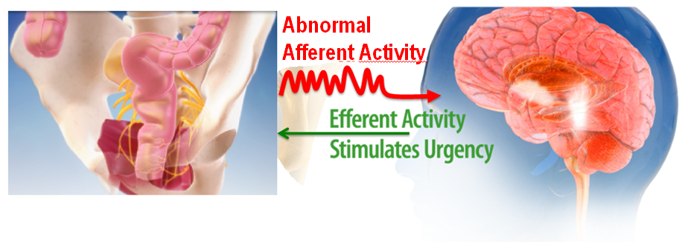
The central role of the brain
  Rectal afferent fibres are critical for sending signals of rectal fullness and discomfort to the brain. It has been suggested that a pontine neuronal centre coordinates defaecation.
  Increasing afferent traffic as the rectum fills would be transmitted via synapses in the sacral cord to the brainstem and midbrain. If the afferent signals exceed a trigger level, the pontine centre would be excited, leading to external anal sphincter relaxation.
[Gourcerol, Bovier et al. How sacral nerve stimulation works in patients with faecal incontinence. Colorectal Dis. 2011 Aug;13(8):e203-11.]

Slide 6
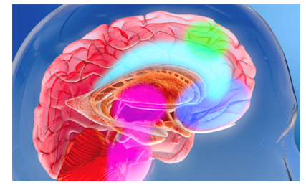
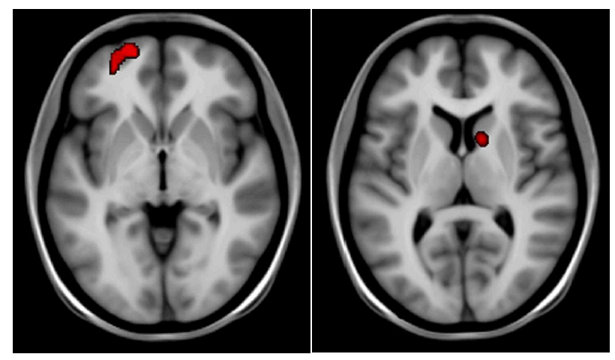
SNM: mechanism of action
  SNM is thought to modulate rectal sensation by activating or deactivating chemical mediating receptors, stimulating the afferent pathway, and changing brain activity relevant to the continence mechanism. [1]
  SNM induces effects on the central nervous system (CNS) such as changes in the contralateral frontal cortex, reflecting focus attention and changes in the ipsilateral caudate nucleus, an area related to learning [2].
[1] Paquette et al. Dis Colon Rectum. 2015 Jul;58(7):623-36. The American Society of Colon and Rectal Surgeons’ Clinical Practice Guideline for the Treatment of Fecal Incontinence.
[2] INCONTINENCE 6th Edition 2017. Eds: Abrams, Cardozo, Wagg, Wein (6th International Consultation on Incontinence, Tokyo, September 2016
[3] Lundby L, Møller A, Buntzen S, Krogh K, Vang K, Gjedde A, Laurberg S. Relief of fecal incontinence by sacral nerve stimulation linked to focal brain activation. Dis Colon Rectum. 2011 Mar;54(3):318-23.

Slide 7

Science or faith?
When Faith Enters
In others, physiological parameters remain unchanged, yet the patient improves substantially. This dissociation suggests mechanisms not yet fully understood — possibly involving cortical reorganization, neuroplasticity, or placebo-independent central effects.
When Science Explains It
In some patients, SNM produces measurable improvements in physiological parameters (manometry, EMG, urodynamics) that correlate with clinical benefit — confirming a mechanistic effect on neural circuitry.
Trial-and-Error Selection
Crossover RCT Evidence
The Honest Answer
SNM delivers reproducible clinical benefit despite incomplete mechanistic understanding — a pragmatic reality in evidence-based medicine
High predictive value of a positive PNE test → pragmatic approach; indications gradually expanded beyond early strict criteria
In ON vs. OFF crossover designs, all patients chose to remain in ON mode — making a pure placebo effect unlikely (Kahlke et al. DCR 2015)
Notes:
7

Slide 8

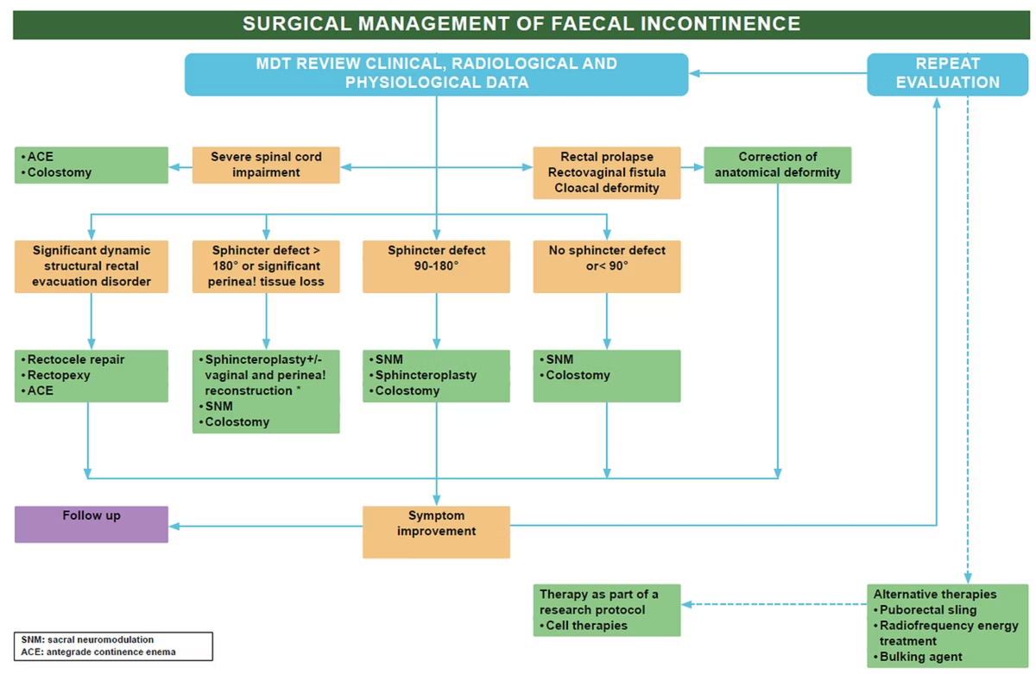
ICI 2023 Guidelines: Surgical Algorithm for Fecal Incontinence
Sphincteroplasty GoR C
Overlapping EAS repair for defined defects. Results deteriorate with time. Redo repair feasible in selected cases.
Sacral Neuromodulation GoR B
Effective for severe FI unresponsive to conservative Tx. May be first-line even with sphincter defect. Benefits sustained medium-to-long term.
Injectable Biomaterials GoR C
Role not established. Optimal agent and injection site uncertain. Use not recommended.
Notes:
8

Slide 9

Long-Term Outcomes: The Evidence Base
89%
36%
≥50% FI Improvement
Complete Continence
At 5 years; FI episodes fell from 9.1/week to 1.7/week (Hull et al. DCR 2013)
Achieved at 5-year follow-up in the same prospective multicenter cohort
7.1 yrs
>70%
Mean Follow-Up
Device Retention at 5 yrs
Clear shift toward SNM as primary intervention: 95.3% sphincteroplasty in 2000 vs. 82.6% SNM in 2013
FIQL of SNM patients comparable to the general population at long-term follow-up (Janssen et al. Surgery 2017)
SNM was superior to Permacol (injectable bulking) for nearly all outcome measures in women with FI following OASIS — Permacol has no place in the treatment algorithm. (Rydningen et al. Colorectal Dis. 2017)
Notes:
9

Slide 10
Key Study: SNM for FI
Long-Term Outcomes & Sexual Function
Brusciano L, Brillantino A, Pellino G, Marinello F, Baeten CIM, Digesu A, Naldini G, Gambardella C, Lucido FS, Sturiale A, Gualtieri G, Riss S, Docimo LSacral nerve modulation for patients with fecal incontinence: long-term outcome and effects on sexual function
FI Outcomes
Sustained long-term reduction in FI episodes with maintained improvement across all validated scoring tools
Why This Study Matters
This multicenter study provides long-term durability data on SNM for refractory FI and uniquely examines sexual function outcomes — a patient-centered endpoint frequently overlooked in the SNM literature.
Sexual Function
SNM demonstrated measurable improvements in sexual function scores — a critical QoL domain in pelvic floor disease
It reinforces the concept that SNM benefits extend beyond the primary symptom, addressing the broader quality-of-life impact of pelvic floor dysfunction, including sexual health.
Clinical Implication
Reinforces SNM as a systemic neuromodulator of pelvic function, not merely an anti-incontinence device
Notes:
10

Slide 11
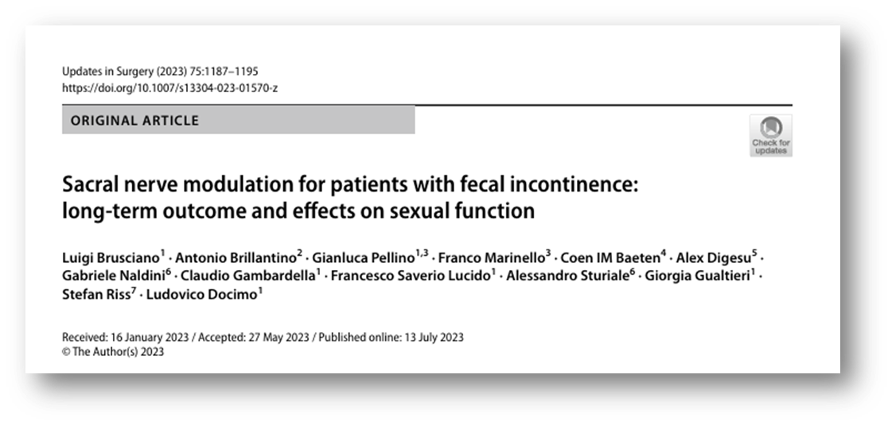

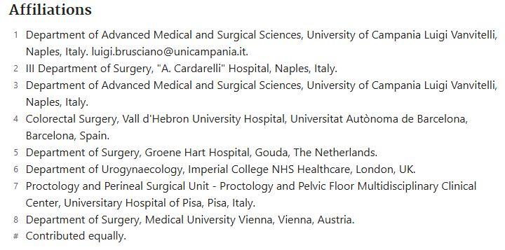




UK
NETHERLAND
VIENNA
SPAIN
ITALY

Slide 12
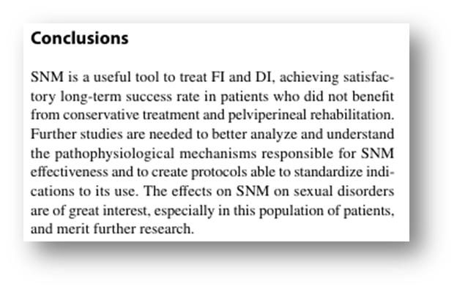
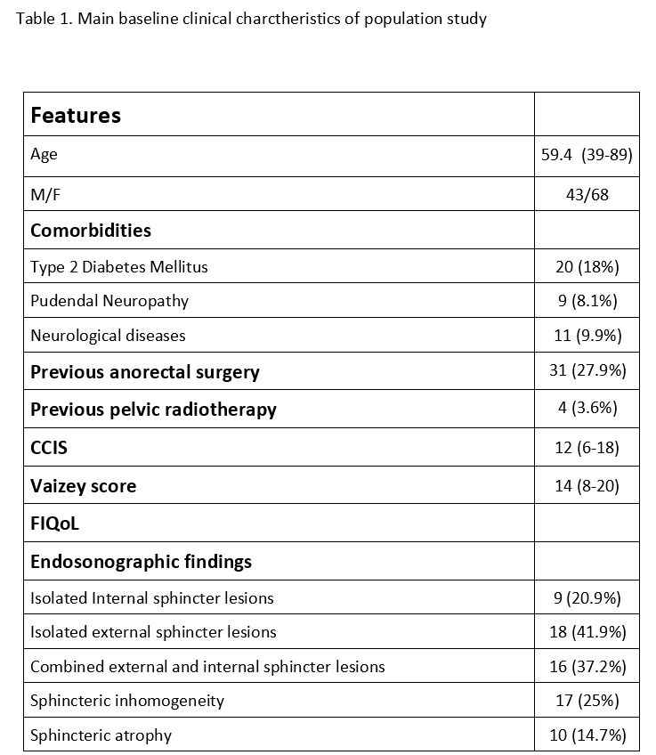


ITALY
SPAIN
UK
AUSTRIA

Slide 13
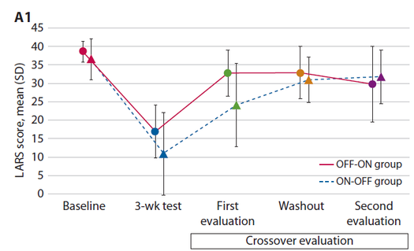
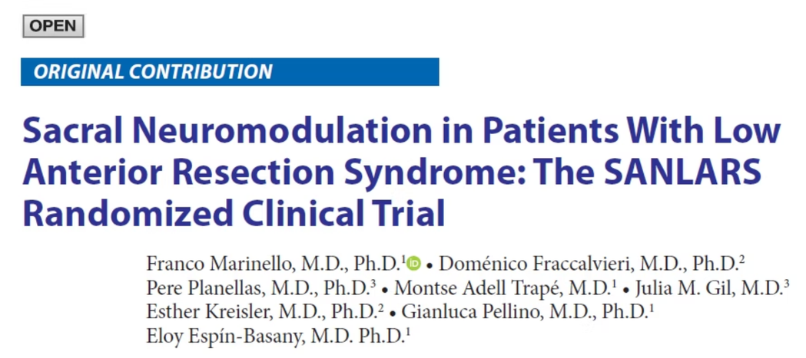
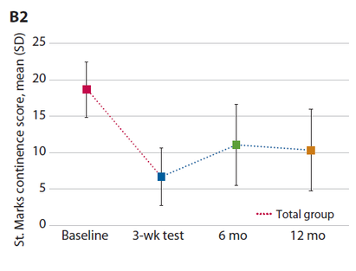
Expanded Indications & Concomitant Benefit
Beyond Primary FI: Real-World Impact
LARS: RCT Evidence
In a retrospective cohort of 52 patients with refractory FI, 48% had associated pelvic floor conditions (dyssynergic defecation, chronic proctalgia). SNM provided concomitant symptom improvement:
  61% — no longer experiencing difficulty evacuating
  67% — resolved incomplete evacuation
  58% — resolved proctalgia
(Bertucci Zoccali M et al. J Gastrointest Surg. 2024)
In a crossover RCT, all patients showed symptom reduction — with better performance when the generator was active. 70% reported HRQoL improvement. (Marinello et al. DCR 2024)
In patients with combined uro-proctological dysfunction, SNM acts simultaneously on multiple systems — making it the ideal single intervention for complex pelvic floor disease.
Notes:
11

Slide 14
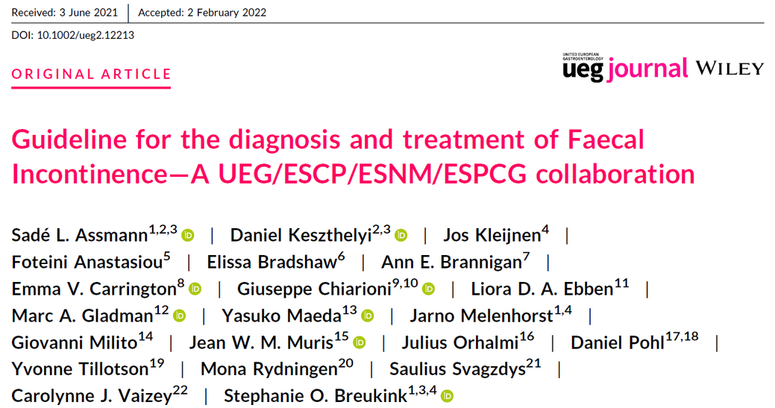
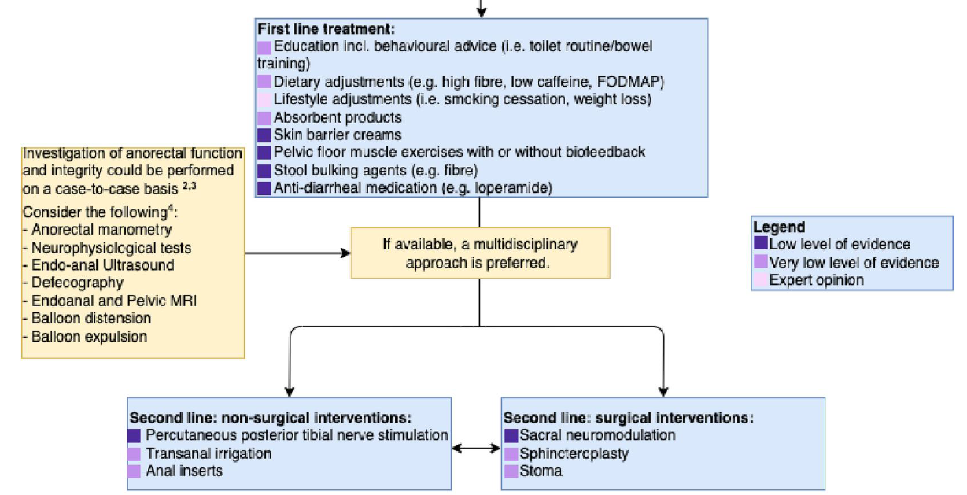
[1] Assmann SL et al. United European Gastroenterol J. 2022 Apr;10(3):251-286. doi: 10.1002/ueg2.12213. Epub 2022 Mar 18. Erratum in: United European Gastroenterol J. 2022 Jul;10(6):606-607

Slide 15
The American Society of Colon and Rectal Surgeons Clinical Practice
Guidelines for the Management of Fecal Incontinence
 | Recommendation strength | Grade quality of evidence
Biofeedback may be considered for patients with FI. | Conditional | Low
Vaginal mechanical inserts are not routinely recommended for FI. | Conditional | Very low
Anal mechanical insert devices are not routinely recommended for FI. | Conditional | Very low
Anal sphincteroplasty may be considered in patients with a defect in the external anal sphincter, but clinical results often deteriorate over time. | Conditional | Low
Repeat anal sphincter reconstruction after a failed overlapping sphincteroplasty should generally be avoided. | Conditional | Very Low
Sacral neuromodulation may be considered as a first-line surgical option for incontinent patients with or without sphincter defects. | Conditional | Low
Injection of biocompatible bulking agents into the anal canal is not routinely recommended for the treatment of FI. | Conditional | Low

Slide 16
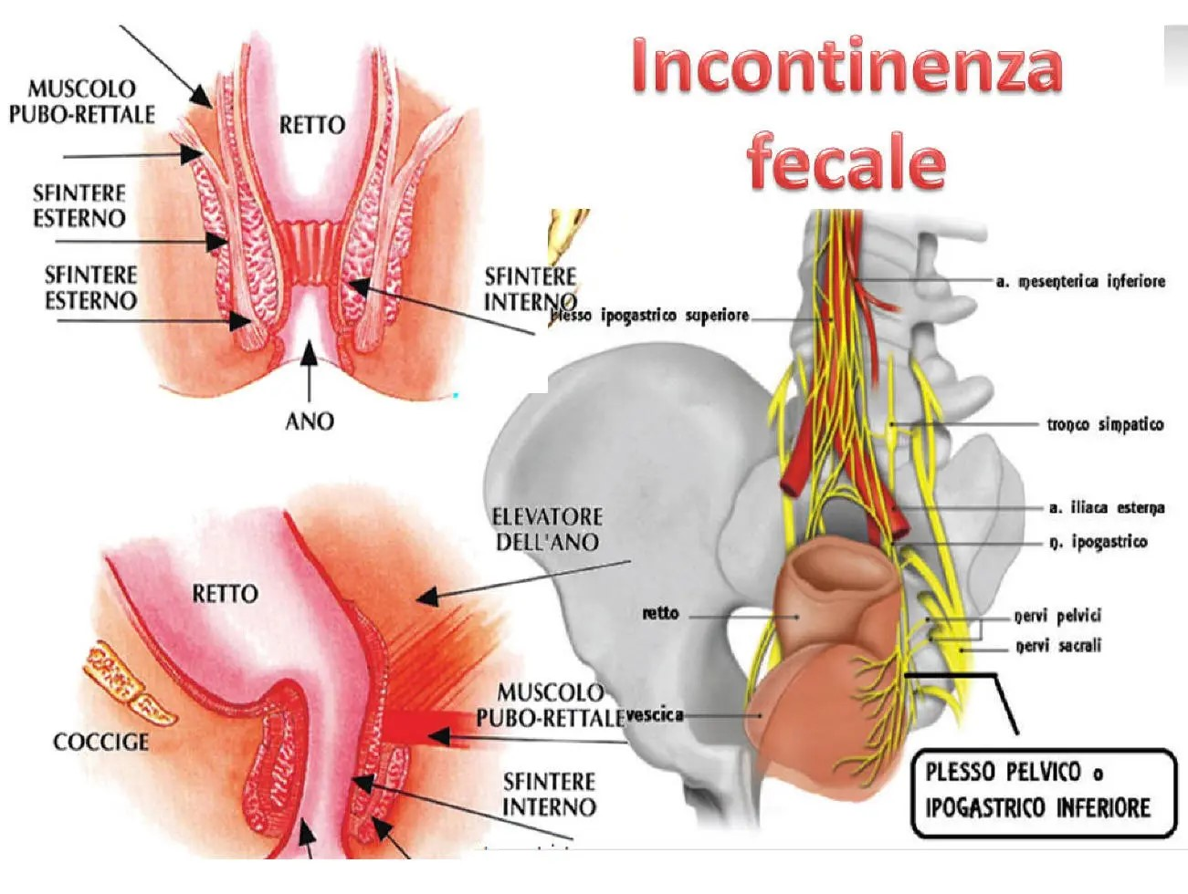
Predictors of SNM for FI
  Low amplitude of the sensory threshold during PNE and lead placement anterior to the sacral cortex were positive predictors of PNE outcome.
  No other predictors have been established such as demographics, technique, symptom severity and cause (age, sex, sphincter lesion, incontinence type).
  Results from numerous studies on predictive factors are inconclusive and none of the variables usually considered in preoperative evaluation are of any help in selecting the appropriate patient for chronic SNM.
  There are conflicting studies whether the presence of an intussusception is a predictive factor for SNM failure
  In a multivariate analysis a concomitant rectocele or enterocele were not predictive for SNM outcome)

Slide 17
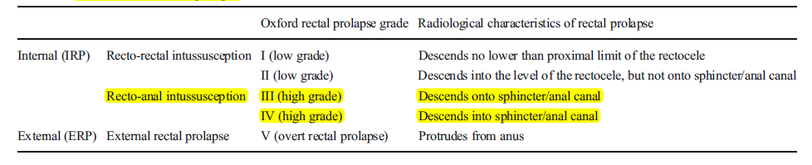
Classification of rectal prolapse
Prapasrivorakul S, Gosselink MP, Gorissen KJ, Fourie S, Hompes R, Jones OM, Cunningham C, Lindsey I. Sacral neuromodulation for faecal incontinence: is the outcome compromised in patients with high-grade internal rectal prolapse? Int J Colorectal Dis. 2015 Feb;30(2):229-34.

Slide 18
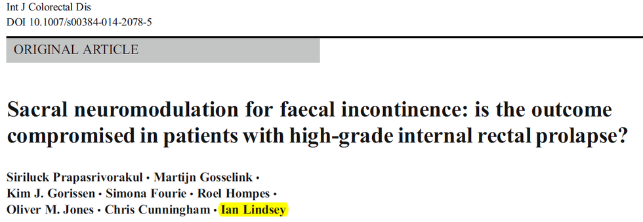
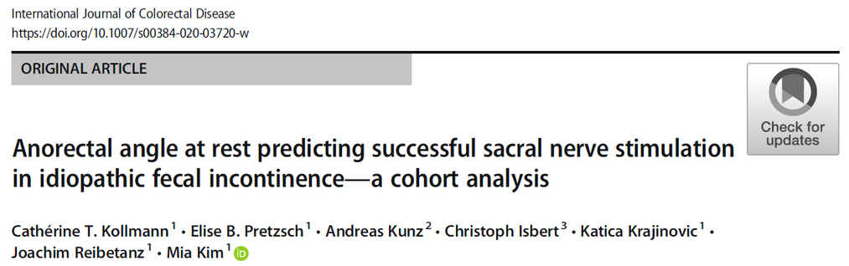
The role of an intussusception?
In a retrospective analysis from 84 patients success at one-year follow-up were significantly lower in patients with a coexisting high-grade internal rectal prolapse (HIRP Oxford Grade III and IV) when compared with those without HIRP (16% versus 52%).
The only predictive factor for a favourable outcome of SNM was an increased anorectal angle at rest. The presence of intussusception was not a predictive factor of success or failure!

Slide 19
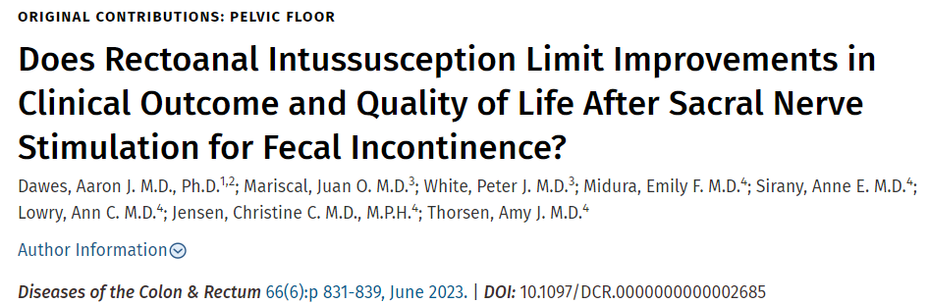
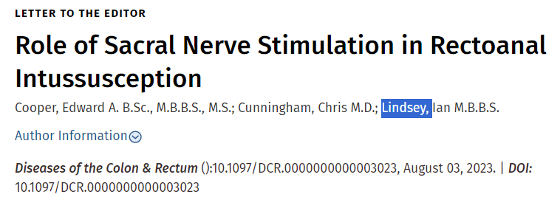
An intussusception is not a contraindication
N=46 patients had concomitant rectoanal intussusception [RAI] (38 grade III and 8 grade IV).
  At 1 year after surgery there was no difference in post-operative Wexner scores (10.4 vs. 9.2) or improvement over time between patients with and without rectoanal intussusception (-6.7 vs. -5.7).
  Similarly, there was no difference in quality of life or frequency of incontinence to liquid or solid stool.
  Conclusion: Appropriate patients with FI and concomitant RAI can and should be considered for SNS...
Perhaps a safer conclusion in the Dawes et al article would be that SNS is successful in Grade 3 prolapse, but further evaluation is required to determine its effectiveness in Grade 4.
[2] Cooper EA, Cunningham C, Lindsey I. Dis Colon Rectum. 2023 Aug 3. doi: 10.1097/DCR.0000000000003023. Epub ahead of print.
[1] Dawes AJ et al. Dis Colon Rectum. 2023 Jun 1;66(6):831-839
.

Slide 20
Safety Profile & Conclusions
Adverse Events — Manageable & Rare
The Verdict
  Pain at implant site: ≈5% (mitigated by smaller modern IPGs)
  Lead migration: 1–4% | Lead breakage: 1–3.4%
  Infection: ≈4% | Wound healing issues: ≈2%
  Explantation rate: 5–13% (therapy failures)
  No severe, irreversible complications reported
SNM has delivered a genuine revolution in the management of functional pelvic floor disorders over three decades.
Despite incomplete mechanistic understanding, the clinical evidence is robust: sustained efficacy, acceptable safety, and broad applicability — including combined uro-proctological dysfunction, LARS, neurogenic conditions, and concomitant pelvic pain.
FDA MAUDE database review confirms real-world safety: 43.2% of reported "complications" reflect need for improved technical support or informed consent, not true adverse events. Only 4 legal cases in 24 years of use. (Carlton et al. Neurourol Urodyn. 2023)
The answer to "Science or Faith?" is: predominantly science — with an honest acknowledgment that the full story is still being written.
  Carlton CE et al. Understanding a decade of safety reporting for sacral neuromodulation in the Food and Drug Administration Manufacturer and User Facility Device Experience database. Neurourol Urodyn. 2023 Nov;42(8):1655-1667.
Notes:
29

Slide 21

MASTER UNIVERSITARIO
DI II LIVELLO IN :
COLONPROCTOLOGIA E PATOLOGIA DEL PAVIMENTO PELVICO
MASTER UNIVERSITARIO DI
I LIVELLO IN:
DIAGNOSTICA STRUMENTALE E RIABILITAZIONE DEL PAVIMENTO PELVICO
DIRETTORE : Prof. Ludovico Docimo
COORDINATORE SCIENTIFICO: Prof. Luigi Brusciano
Scopri di più e iscriviti:
www.masteriabilitazionedelpavimentopelvico.it
www.mastercolonproctologia.it
www.proctologianapoletana.it

